Slide 1
Behavioural & Experimental Economics Economic Experiments
Adrien Fillon
University of Cyprus

Slide 2
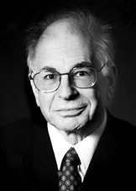

People you should know
Nobel Prize in Economics 2002
Daniel Kahneman Princeton University, USA “for having integrated insights from psychological research into economic science, especially concerning human judgment and decision-making under uncertainty”
and Vernon L. Smith George Mason University, USA “for having established laboratory experiments as a tool in empirical economic analysis, especially in the study of alternative market mechanisms”.

Slide 3
Experimental vs. Behavioural Economic
Behavioural Economics:
The study of human decision making related to economic problems, using insights from psychology.
Experimental Economics:
An empirical method (not a topic!) used to generate data in a controlled fashion, in order to study problems in a variety of economic fields.
Economic experiments are perhaps the most important source of data for behavioral economics.

Slide 4
The Purposes of Running an Experiment
Speaking to Theorists
Searching for Facts
Searching for Meanings
Whispering in the Ears of Princes
Roth Al E (ed), Laboratory Experimentation in Economics: Six Points of View, Cambridge University Press, 2005:

Slide 5
What Makes a Good Experiment?
Should an experiment replicate reality?
No! We have field studies for that.
Should an experiment replicate a formal model?
No! We have theory for that.
A good experiment tries to capture the most relevant features of reality in a simple, carefully controlled environment. Good experiments are usually designed to test specific hypotheses, sometimes derived from the implications of some economic theory and other times based on previous observations in either experiments or field data.
Notes:
The answer depends on what you are testing or exploring, and who you are talking to.
•Loosely speaking, a good experiment is one that controls for the most plausible alternative hypotheses that might explain what is being observed, and therefore allows you to distinguish among them. But what are the most plausible alternative hypotheses may depend on who you are talking to (which is why economists and psychologists sometimes run rather different experiments concerning roughly similar phenomena). The most plausible alternative hypotheses may also depend on recent developments in theory, in the laboratory (yours or someone else’s), or in the field. So a “good experiment” is a creature of its time (and may even make itself obsolete, as when it controls for a hypothesis which it discredits, making those controls unnecessary in future experiments).
One of the first goals of experimental design is to protect ourselvesfrom fooling ourselves into believing what we want to believe.
Good design is often about protecting yourself from jumping to wrong conclusions
Science is done by people who are following up on their intuitions, and (often) investigating hypotheses that they believe to be true. The same intuition that causes you to believe the hypothesis might give you a good idea of situations in which the conclusions of the hypothesis will hold. But if there are other reasons that those conclusions might hold, you have to make sure that you haven’t just created a situation that gives you the results you expect, but not for the reason that you believe.
15

Slide 6
What Makes a Good Experiment?
One of the first goals of experimental design is to protect ourselves from fooling ourselves into believing what we want to believe.
Good design is often about protecting yourself from jumping to wrong conclusions
If there are other reasons that those conclusions might hold, you have to make sure that you haven’t just created a situation that gives you the results you expect, but not for the reason that you believe.

Slide 7
What is a Controlled Experiment?
As much as possible, the experiment controls all elements of the environment in which the experiment takes place.
Preferences, beliefs, incentives, technology, and initial endowments
Institution (rules of the game)
Possible actions
Sequence of actions
Information conditions
Framing (language, story)
Notes:
The experimenter determines the rules – what choices are available to subjects, when decisions are made, and what the consequences of these decisions will be.
The experimenter controls subjects’ payoffs as a function of the actions they take.
The experimenter controls the information that is available to subjects.

Slide 8
Advantages of (Lab) Experiments – Enhanced Control
Subjects are randomly assigned to the treatment conditions – rules out selection bias.
It is known which variables are exogenous and which are endogenous – allows to make causal inferences.
Experimenter can make ceteris paribus changes in the exogenous variables – allows for the isolation of true causes.
Many variables that cannot be directly observed in the field can be observed in the lab.
Reservation wages, anticipated versus non-anticipated money supply shocks.

Slide 9
Advantages of (Lab) Experiments – Enhanced Control
Information conditions and exogenous stochastic processes can be controlled.
Important for the testing of models with asymmetric information.
Better direct controls are often a substitute for complicated econometric methods.
Replicability – provides the basis for statistical tests. Critics can run their own experiments.

Slide 10
Advantages of (Lab) Experiments – Enhanced Control
Enhanced control opportunities often imply that the experimenter knows the predicted equilibrium exactly.
Equilibrium and disequilibrium actions can be explicitly observed.
Quick or sticky adjustment can be explicitly observed
Example: What are the supply and demand schedules that underlie observable price & quantity data? Is the observed price-quantity combination a competitive equilibrium?

Slide 11
Advantages of (Lab) Experiments -Theory Free Comparison of Institutions
To learn something about the efficiency properties of institutions it is not necessary to have a full theory that explains and predicts behavior
Welfare measure: total money earnings of all subjects in the experiment divided by the total earnings.
Example: double auction versus one-sided continuous auction
Check the robustness of institutions in different environments.

Slide 12
Potential threats
Moral and ethical considerations
The nature and extend of scrutiny
The context in which decisions are embedded
Self-selection of individuals
The stakes of the game

Slide 13
What makes a good design? (but not necessarily a good paper…)
The design should allow you to appropriately address the research question.
Determine hypotheses to be tested.
Control all non-essential factors.
Eliminate potential noise.
Only change 1 variable per treatment
Economic experiments: use incentives
Beware of “sexy-ness” of the design…

Slide 14
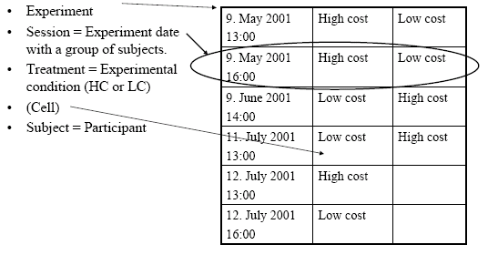
Clarification of Terms
Notes:
Treatment: a particular condition of the experiment - Often there is a (main) treatment and a control treatment (or more). - Everything else kept equal, only one change • An experiment usually consists of several sessions. - In a session a group of people takes part in the experiment at a particular date and place. • Subjects are participants in the experiment.

Slide 15
Between- vs. Within- subjects design
Between-subjects:
Each treatment run with different subjects.
Subjects randomised to treatment: in expectation same subject pool, so comparison valid.
Expensive.
Within-subjects:
Several treatments are run with the same subjects.
Control for individual fixed effects
Allows for individual comparison
Cheaper. More powerful pair-wise matched comparisons, allows testing across-task consistency.
Order effects. Experimenter demand effects.

Slide 16
Design Basics
Treatments:
Orthogonal design
Factorial design
1st price sealed-bid
auction
2nd price sealed-bid
auction
English
auction
Baseline
with
competition
with
communication
with
both

Slide 17
Design Basics
Treatments:
Orthogonal design
Factorial design
Efficient design: spend your money carefully (power statistics)
1st price sealed-bid
auction
2nd price sealed-bid
auction
English
auction
Baseline
with
competition
with
communication
with
both

Slide 18
Design Basics
Beginners mistakes to avoid:
Design too complex across cells (3x2x4) with too few observations per cell
Experimental predictions that are too close together

Slide 19
One Shot vs. Repeated Interactions
Pro One-Shot
Strong incentives for decision
No strategic spillovers across periods
Easy to perform and short
Pro repetitions
Learning
Possible to observe dynamics, e.g., convergence to equilibrium
More observations

Slide 20
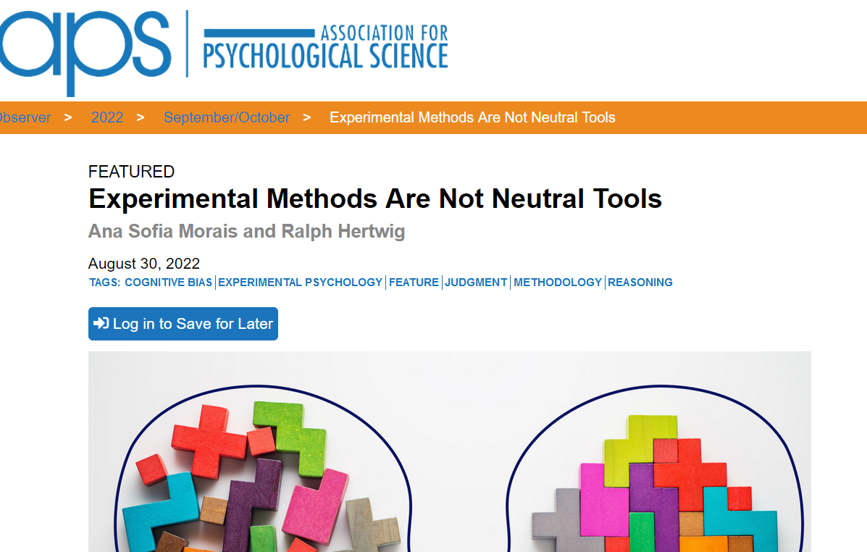
One Shot vs. Repeated Interactions
The combined use of descriptive and experiential protocols would also help shed light on the development of statistical reasoning across the lifespan and across species. Developmental psychologist and APS President Alison Gopnik once asked, “Why are grown-ups often so stupid about probabilities when even babies and chimps can be so smart?” (Gutíerrez, 2014).
Experimental protocols may be a key factor in understanding this discrepancy (Schulze & Hertwig, 2021). Whereas studies with adults typically use descriptive protocols, the protocols used with infants and, similarly, with nonhuman animals tend to involve firsthand experience of information.

Slide 21
Paper and Pencil vs. Computerized
Advantages of computerized experiments:
Better control
Fewer mistakes in conducting the experiment
Less interaction with the experimenter
Complicated experiments (e.g. market
experiments, repeated public goods experiments)
are easier to carry out.
Payment files are automatically written
Automatic collection of data
Many things can be recorded more easily recorded, for example response times

Slide 22
Experimenter Demand Effects
Zizzo (2010)
Subjects might derive (cognitive or social) cues from instructions etc., and behave accordingly.
That is, they do what they do in a certain treatment
because this is what they think the experimenter wants them to do (in this treatment),
and not because the treatment had a direct effect on their preferences/behaviour/etc.
Difficult to distinguish, except if the experimenter demand effect would be orthogonal to the hypothesized treatment effect, or would go in the opposite direction.
→ less problematic when treatment comparison is the main objective of experiment, not absolute behavior in between-subjects studies.

Slide 23
Experimental design issues
Other issues
Strategy method
Order effects
Chained tasks: Incentive compatibility
Randomisation, counterbalancing, session effects

Slide 24
Deception
Social psychology
Deception by commission (i.e., confederate)
Experimental economics
Taboo to use deception in the lab
Field experiment: seems to be used more

Slide 25
Moral Issues / Privacy
Privacy laws
Ethics and human subject commitees

Slide 26
Subject Pool
The subject pool is an extremely precious resource for experimenters
Correspondingly, it should be dealt with very carefully and cautiously
ETHICS requirement
Different recruitment procedures
Orally, person to person
Leaflets and lists on blackboards
Email lists
Web-based database → ORSEE

Slide 27
No-shows
Almost any experimenter runs into trouble if there are too few participants showing up for an experiment session
Solution approach: reserve + incentives
Reserve: we invite more participants than actually needed, showing up on time secures a minimum payment (=showup fee), participants who are not needed can leave right away
Reputation system:
3 no-show-, you are out!

Slide 28
Typical structure of a lab experiment
Before: Motivation and research question, hypotheses, instructions, software, ethics approval , recruitment
Participant check-in
Informed consent
Control: side-talk, mobile phones, computer use, etc.
Instructions distributed (, read aloud)
Answer questions privately, repeat publicly if appropriate
(Comprehension test, practice rounds)
Run it: decisions are made on computer, paper and pencil
SAVE THE DATA
Post-experimental questionnaire (, debriefing)
Participants paid and dismissed
Data analysis, paper writing

Slide 29
Why use incentives?
Psychologists don’t use them!
For the questions economists ask it is important.
Even if subjects want to behave “truthfully” it is hard in hypothetical situations.

Slide 30
How to incentivize?

Slide 31
How to incentivize?
Money
Gift cards
Food
Mugs
Time
Status
Entertainement
Donations to 3rd parties
Electrical shocks
Killing mice
Buying CO2 emissions
…

Slide 32
How to incentivize?
Money
Gift cards
Food
Mugs
Time
Status
Entertainement
Donations to 3rd parties
Electrical shocks
Killing mice
Buying CO2 emissions
…
The best option depends on the research questions!

Slide 33
How to incentivize?
Make incentives salient: e.g. pay in cash right away.
Pay enough!

Slide 34
Pay enough or don’t pay at all Gneezy and Ructichini, QJE 2000
“IQ testing” style exam
With no / low / high / very high incentives

Slide 35
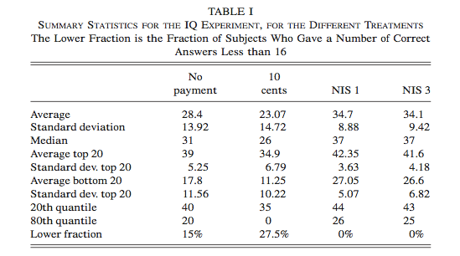
Pay enough or don’t pay at all Gneezy and Ructichini, QJE 2000

Slide 36
How to incentivize?
Make incentives salient: e.g. pay in cash right away.
Pay enough!
Pay one round or all? Or some??
Wealth effects
Hedging
Make them earn it?

Slide 37
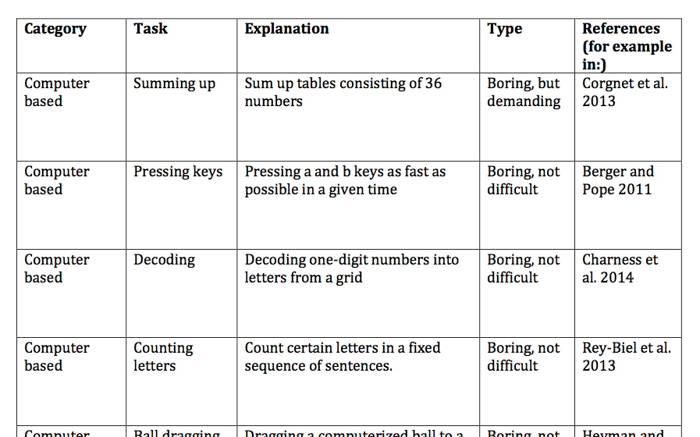
Real effort tasks

Slide 38
Unintended incentives and what to do about them
Risk (more later)
House money effects
Utility from winning
Social preferences
Cognitive costs
Intrinsic motivation
Time preferences
Experimenter demand
Notes:
House Money : play with other money

Slide 39
Online experiments

Slide 40
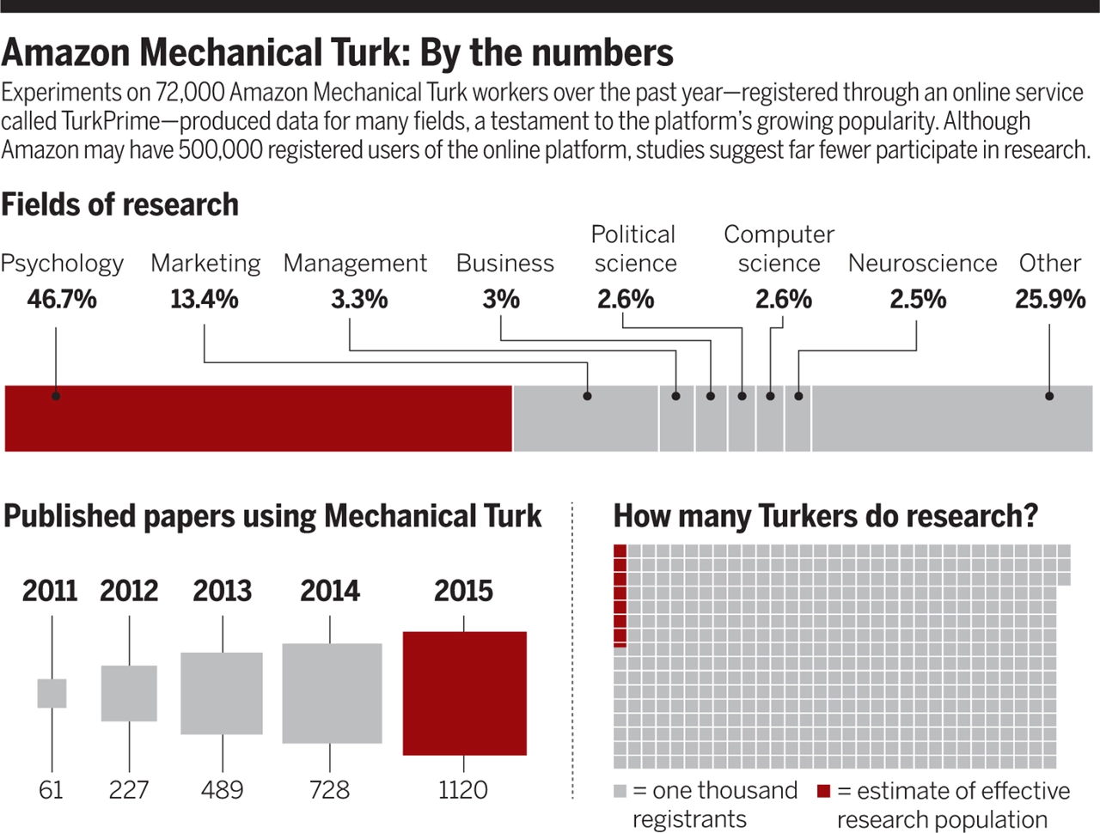
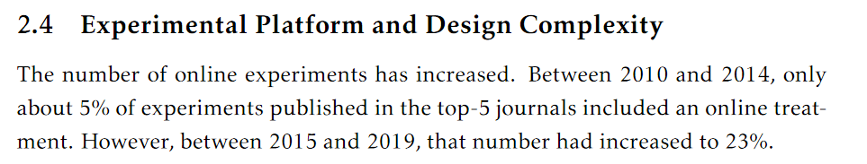
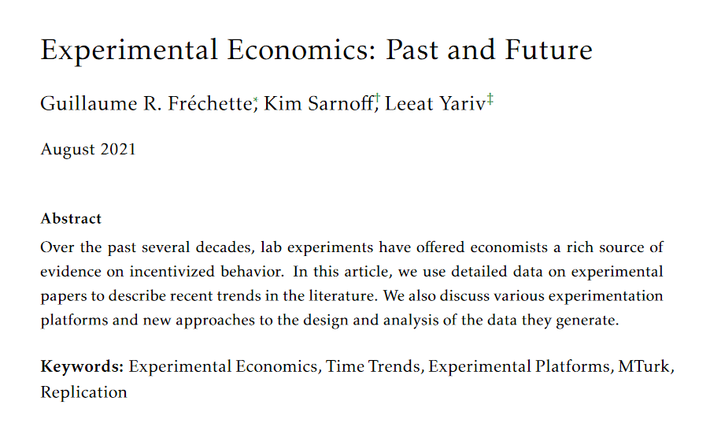
Overview
Bohannon, 2016
Notes:
Why is online experiment important.
Looks great – treds see it is increasing, more importantly in psychology unti 2015.

Slide 41

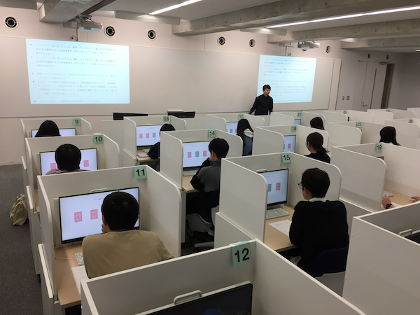
Advantages of Online experiments
The basic behavioral patterns (comparative statics) are replicable online.
Online experiments are quite easy to run
Immediate access to a large and diverse subject pool
Require far less money and time
Less "experimenter effect" and other effects relate to "subjects knowing they are in an experiment"
Notes:
Once Auto, a lot of easy to run

Slide 42

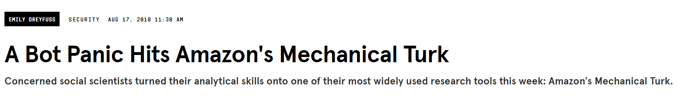
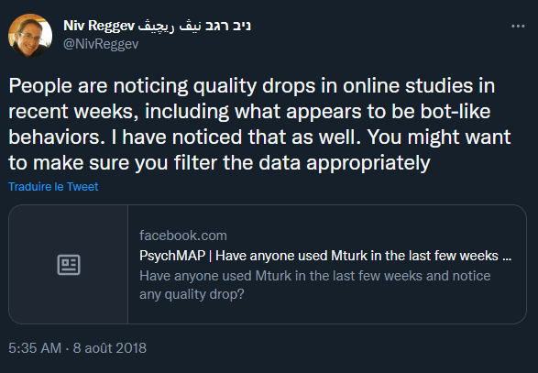
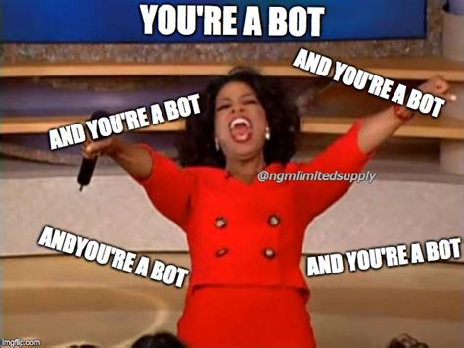
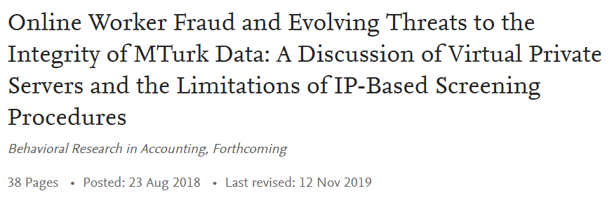
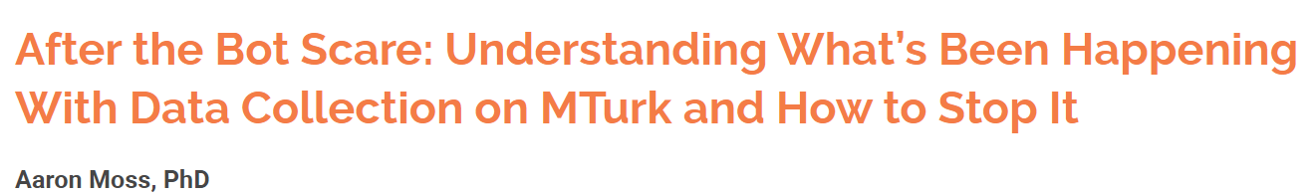

Slide 43
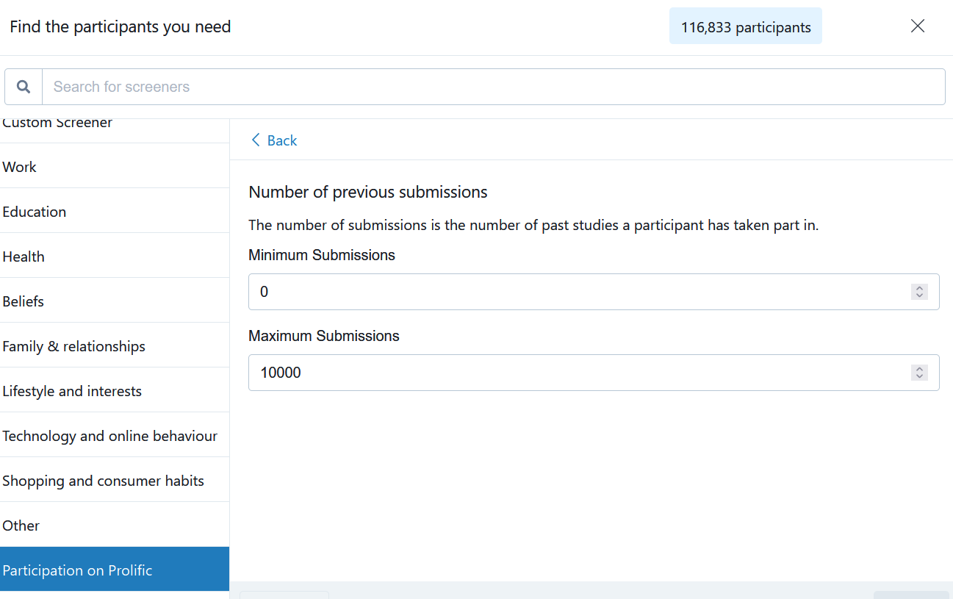
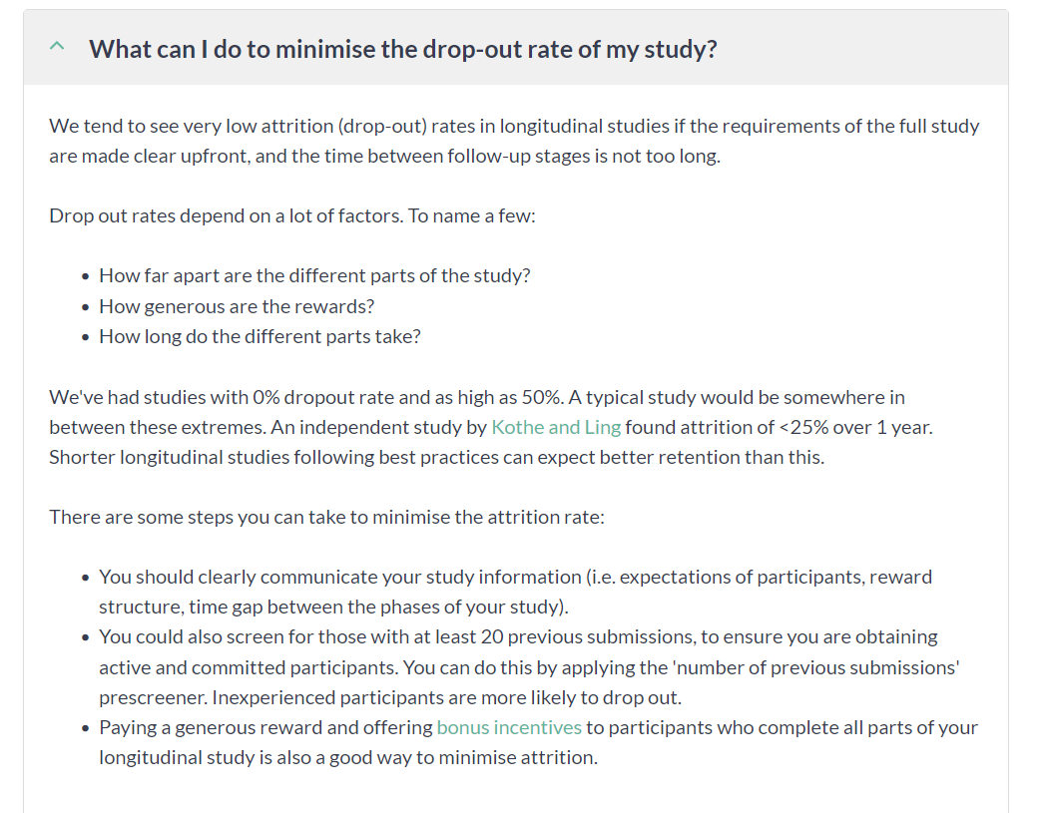
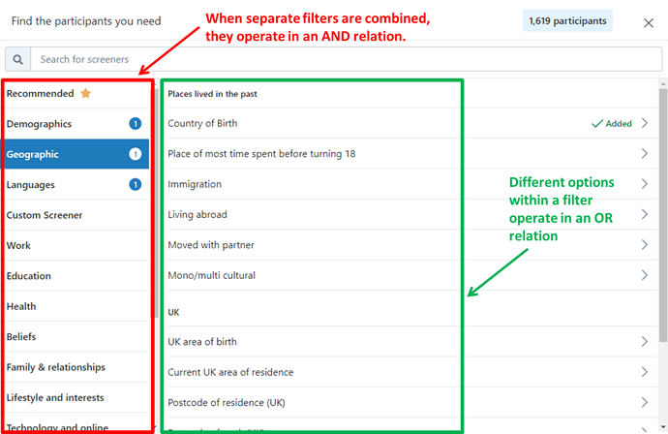



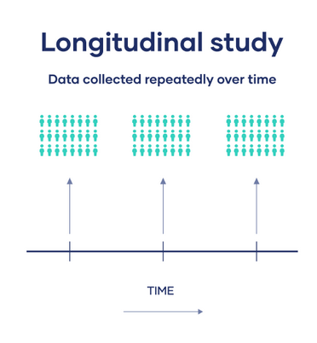
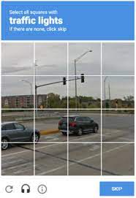
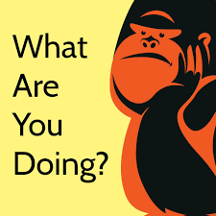

Challenges
Bots and duplicates
Experienced subjects
Control in experimental environment
Dropouts
Communicate
Notes:
What are Mturkers (are they representative of the general population) ?
What if they do it as a regular work ?
What if they multi-task ?
What if they do something during the passation (lisntening to music etc ?)
How can we control it ? (do we need to control it ?)
How can we be sure it does not influence the results ?
Filter
Manipulation check
Attention check

Slide 44
Challenges
Bots and duplicates
Experienced subjects
Control in experimental environment
Dropouts
Only some types of experiments can be run
Common knowledge among participants
Deception

Slide 45
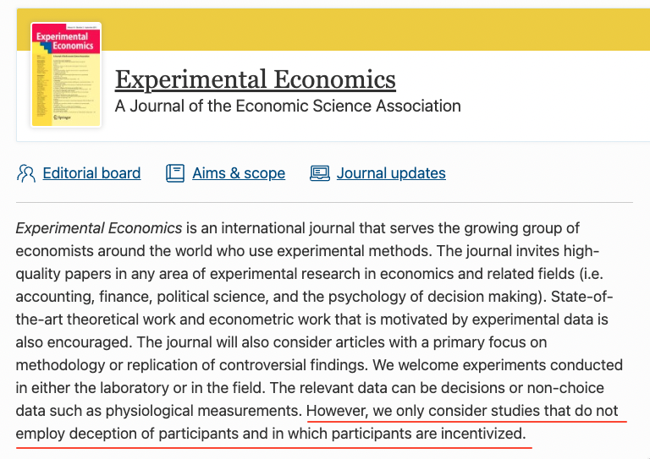
Deception
There is a strong norm against the use of deception in experimental economics (Ortmann, 2019)
Unethical
Maintain experimental control
Negative externalities
However, deception is allowed in some other disciplines.

Slide 46
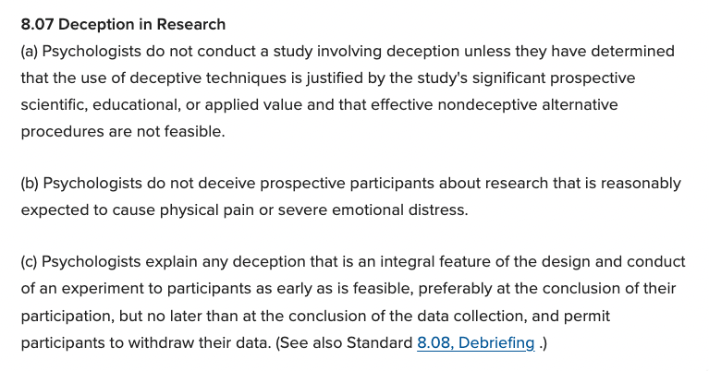
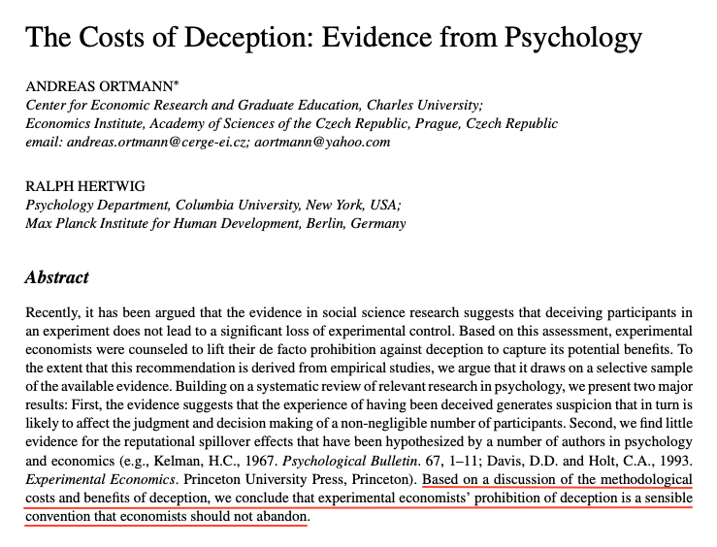
Economists can take steps to highlight to their subjects that they adhere to the no-deception rule
present arguments to others that deception is a threat to the usefulness of these markets
﻿The American Psychological Association (https://www.apa.org/ethics/code#807)

Slide 47
